Slide 1

^{10th} International Conference on Applying New Technology in Green Buildings (ATiGB 2025)
(25 – 26 July, 2025 )
Organized by University of Technology and Education,
University of Danang (Vietnam).
Improved Stroke Prediction Using Medium Tree and Coarse Gaussian SVM Classifiers
Paper ID: 129
Kamali Ramesh, Gnanajeyaraman Rajaram
Saveetha School of Engineering, SIMATS, Chennai, India

Slide 2
Paper Outline
Introduction
Research Objective
Related Works
Problem Definition
Proposed Methodology
Dataset and Preprocessing
Results & Discussion
Conclusion
Future Enhancements
References

Slide 3
Introduction
Stroke is a major global health concern, with high morbidity and mortality.
CT and MRI are costly and limited in low-resource settings.
ML provides scalable, cost-effective stroke risk prediction.
Importance: Enables early intervention and reduces healthcare burden.
Problem: Need for interpretable, accurate, and deployable models.

Slide 4
Research Objective
Predict stroke risk using interpretable ML models.
Use Medium Tree and Coarse Gaussian SVM.
Evaluate in MATLAB with 5-fold cross-validation.
Main Contributions:
- Robust preprocessing: Imputation, SMOTE, scaling.
- Accurate performance metrics: Accuracy, Precision, Recall, F1

Slide 5
Related Works
2022 – Y. Li et al.
Gaussian SVM was validated in fairness-based judicial data, demonstrating effectiveness in handling non-linear, high-dimensional inputs.
2024 – Vickram and Muthu
Developed a MobileNet-based CNN model for early brain tumor detection, highlighting the power of lightweight ML in medical imaging.
2025 – Reetha and Gnanajeyaraman
RNN + Attention used for schizophrenia detection with EEG, reinforcing the importance of interpretable, scalable diagnostic tools.

Slide 6
Proposed Methodology
Data Preprocessing:
- Mean imputation (BMI), Label Encoding, Feature Scaling
- Class Balancing via SMOTE
Classifier Models:
- Medium Tree: Simple, interpretable
- Coarse Gaussian SVM: RBF kernel for non-linear patterns

Slide 7
Dataset Description
Source: Public healthcare stroke dataset
Total Records: 1800 patients
Features:
- Age, Gender, BMI
- Heart Disease, Hypertension
- Blood Sugar, Work/Marital Status
- Residence, Smoking

Slide 8
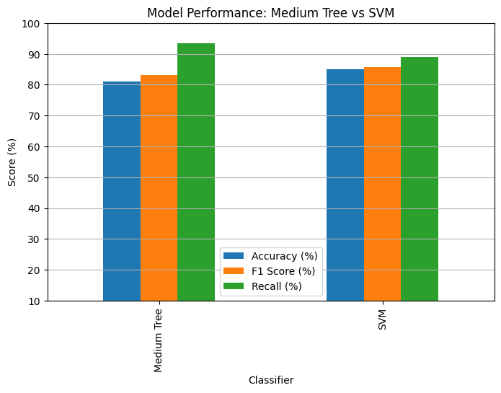
Results and Discussion
Classifier | Mean Accuracy | Std. Dev.
Medium Tree | 81.60% | 1.50%
Coarse Gaussian SVM | 85.62% | 2.64%
- Coarse Gaussian SVM outperforms with higher consistency.
- T-Test: Significant difference (p < 0.001)

Slide 9
Conclusion
Coarse Gaussian SVM model demonstrated superior accuracy.
Stroke prediction models are reliable and interpretable.
Models can support clinical diagnosis and early intervention.

Slide 10
Future Enhancements
Integrate larger and more diverse datasets.
Add clinical features: ECG, cholesterol, family history.
Explore advanced models: CNN, Random Forest, XGBoost.
Deploy via mobile and IoT health apps.
Add Explainable AI (XAI) for trust and transparency.

Slide 11
References
Feigin V. L., Norrving B., and Mensah G. A., “World Stroke Organization: Global Stroke Fact Sheet 2025,” International Journal of Stroke, vol. 20, no. 2, pp. 132–144, Feb. 2025. doi: 10.1177/17474930241308142
Elreedy D., and Atiya A. F., “A Comprehensive Analysis of Synthetic Minority Oversampling Technique (SMOTE) for handling class imbalance,” Information Sciences, vol. 505, pp. 32–64, Dec. 2019. doi: 10.1016/j.ins.2019.07.070
Vickram A. S., and Sowndharya B. B., “Automatic Normal/Infected Blood-Cell Analysis for Malaria Detection with Lightweight Deep-learning,” in Proc. 2024 2nd Int. Conf. on Self Sustainable Artificial Intelligence Systems (ICSSAS), Oct. 2024, pp. 877–881.
Reetha L., and Gnanajeyaraman R., “Schizophrenia Detection via EEG using RNNSczNet with Attention Mechanisms and ReUL Activation,” in Proc. 2025 Int. Conf. on Electronics and Renewable Systems (ICEARS), Tuticorin, India, 2025, pp. 301–306. doi: 10.1109/ICEARS64219.2025.10940214
Li Y., Huang H., Guo X., and Yuan Y., “An Empirical Study on Group Fairness Metrics of Judicial Data,” IEEE Access, vol. 9, pp. 149043–149049, 2021. doi: 10.1109/ACCESS.2021.3122443

Slide 12
Thank You

